Slide 1

M.U.S.H (Much User, Such Hex)
Brian Suchy
Jim Gildersleeve
Guilherme Abinader
Songyu Wang

Slide 2
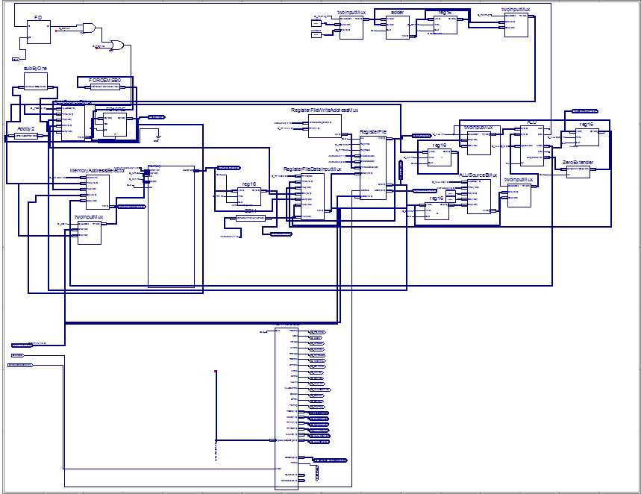
The Processor
PUSH/POP
WB
DATAPATH
Fetch/Decode
I/O
CONTROL

Slide 3
Unique Aspects
Quick register based commands
Power Instructions (Push, Pop, Branches, Mov)
G.H.E.T.T.O Assembler (grandly highly eternally totally titanically optimized)
Verilog
Made with L.O.V.E (Lots of violent emotions)
Emulator
MUSH file type

Slide 4

Potential Changes
Jumping to label pseudo instruction.
Pipelining
Ternary branching
Exceptions
Latches -> DFF’s

Slide 5


Challenges
Xilinx
Euclid’s
Timing
Jumps

Slide 6
Performance
Bytes to store relPrime = 47 Bytes (16-bit bytes)
Bytes to store Euclid’s = 28 Bytes (16-bit bytes)
Instructions for relPrime(0x13B0) = 112,372 Instructions
Cycles for relPrime(0x13B0) = 388,157 Cycles
CPI for relPrime(0x13B0) = 3.45 Cycles/Instructions
Cycle Time = 9.219 ns per Period (108.470 MHz)
Total execution time for relPrime(0x13B0) = 3578419.383 ns (.003 s)

Slide 7
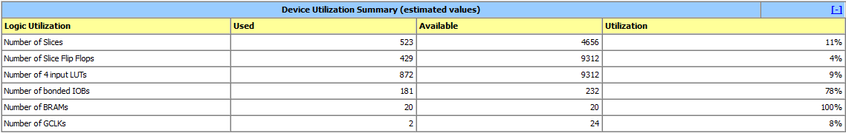
Device Utilization Summary

Slide 8
Takeaways
HDL > Schematic Capture
Single Cycle > Multicycle (unless it is pipelined)
Emulating > Simulating
Debugging > Brainstorming
Altera > Xilinx

Slide 9

QUESTIONS?

